Slide 1

Safe Sharing: Access Control for Cloud Stored Data
by
G. Ajay Kishore
Roll No. 204G1A0506
M. Mounika
Roll No. 204G1A0561
T. Harsha Sri
Roll No. 204G1A0536
B. Bhavana
Roll No. 204G1A0522
Under the guidance of
Mr. M. Narasimhulu M.Tech (Ph.D)
Assistant Professor
Assistant Professor
Department of Computer Science and Engineering
Srinivasa Ramanujan Institute of Technology
Autonomous
Rotarypuram Village, B K Samudram Mandal, Ananthapuramu – 515701.
2023-2024

Slide 2

Contents
Abstract
Introduction
Proposed System
Design
Implementation
Output
Conclusion
References

Slide 3
Abstract
The rapid expansion of cloud environments has brought about a significant challenge to secure data storage. This is a critical consideration for every user when decided to move the data online. To address this challenge, various solutions have been proposed, with two prominent approaches being Searchable Symmetric Encryption and Attribute-Based Encryption. SSE offers protection against both external and internal threats. It allows for efficient search capabilities while maintaining the confidentiality of the data. In an SSE technique, all data is usually encrypted using a single key. The entire encrypted database would need to be downloaded and re-encrypted with a new key if a user was to be revoked. Conversely, though, ABE offers a more granular approach to access control by encrypting data based on attributes and policies. This means that different users or groups can be granted different levels of access to the data based on their attributes.
Keywords: Encryption, Cryptography, Access Control, Searchable Symmetric Encryption (SSE), Attribute-Based Encryption(ABE)

Slide 4
Introduction
Cloud computing has significantly impacted daily life, being used by both large corporations and regular internet users.
Maintaining the security of data in the cloud is challenging due to it being managed by third parties, leading to suspectibility to internal attacks.
Symmetric Searchable Encryption (SSE) enables local encryption before cloud storage, but lacks user revocation support, while Attribute-Based Encryption (ABE) offers fine-grained access control with potential efficiency challenges for large datasets.
Secure authentication and encryption techniques are vital to protect data in transit and at rest, reducing the risk of unauthorized access.
The goal is to establish a comprehensive access control solution that balances security with usability, enabling secure data sharing and collaboration in cloud environments while mitigating the risks associated with unauthorized access and data exposure.

Slide 5
Proposed System
To resolve the issues in the previous system, We proposed the approach which is compatible with deployment models for private, communal, or hybrid clouds. The suggested framework consists of the sensitive data in the cloud is encrypted using a hybrid encryption approach. Before the data is transferred to the cloud, it will be encrypted with a public key. We have specific access that only specific individuals can access the cloud.
An authorized user has the ability to view and edit cloud data information. A user can extract a certain block of code using the SSE Algorithm and use it to decrypt a particular file. Not all users of the ABE Scheme will be able to access data; authentication will only be granted to specific users.

Slide 6
Design - Sequence Diagram

Slide 7
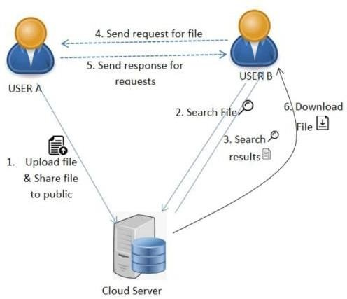
Design - System Architecture

Slide 8
Implementation
User Modules:
Register : user can enter the details and he can register.
Login : user can login with his valid credentials. If user enter invalid credentials then it can be redirect into login page. If user enters valid credentials then it can be redirect into user home.
Upload : Here, User can Upload the files.While uploading the file it can be store into encrypted format and generates searchable keywords.
View Files : The user view the uploaded files and share files to other users.
Search: user can search for a file based on keywords. If file has been found send request to file uploaded user .
View request : In this user view the request from other users for their file
then user can accept/ Reject the request .
Status : The user view the file requested status, i.e. pending and Accepted.
Download : user can download the file if his request is accepted Encrypted file converted into original format can be Download.

Slide 9
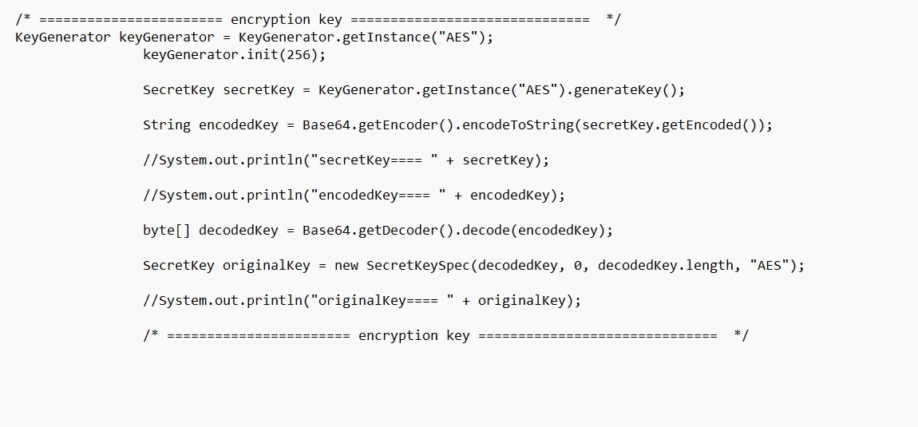
Implementation

Slide 10

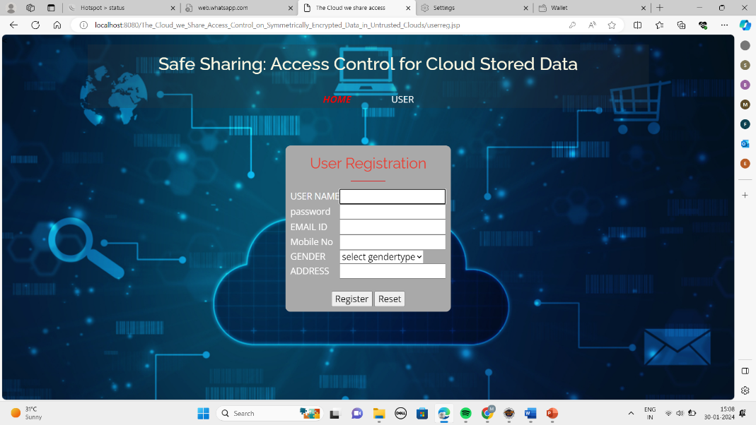
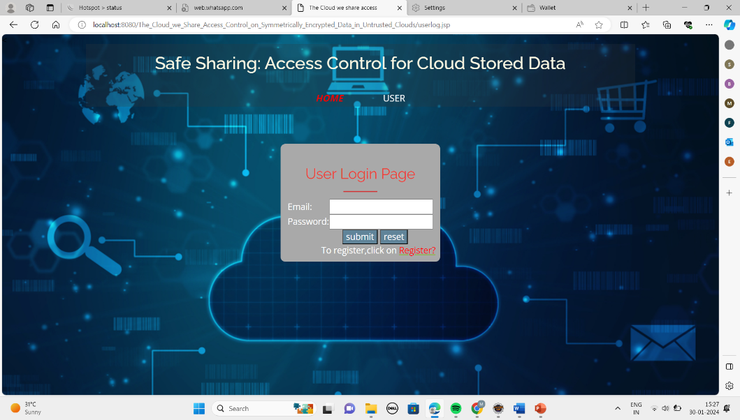
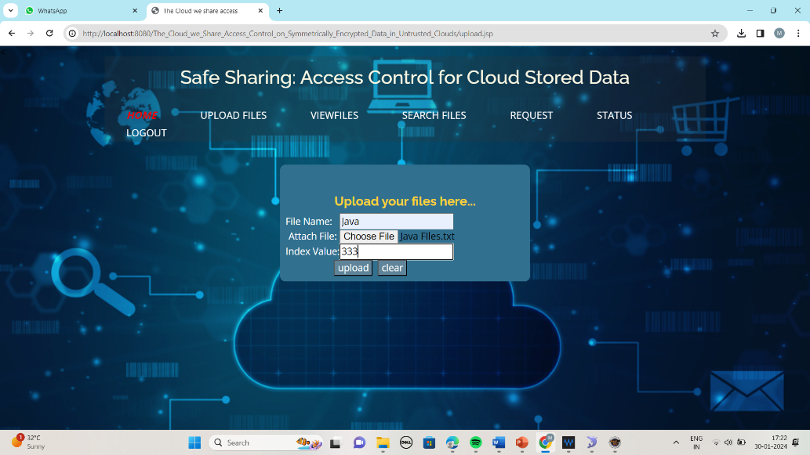
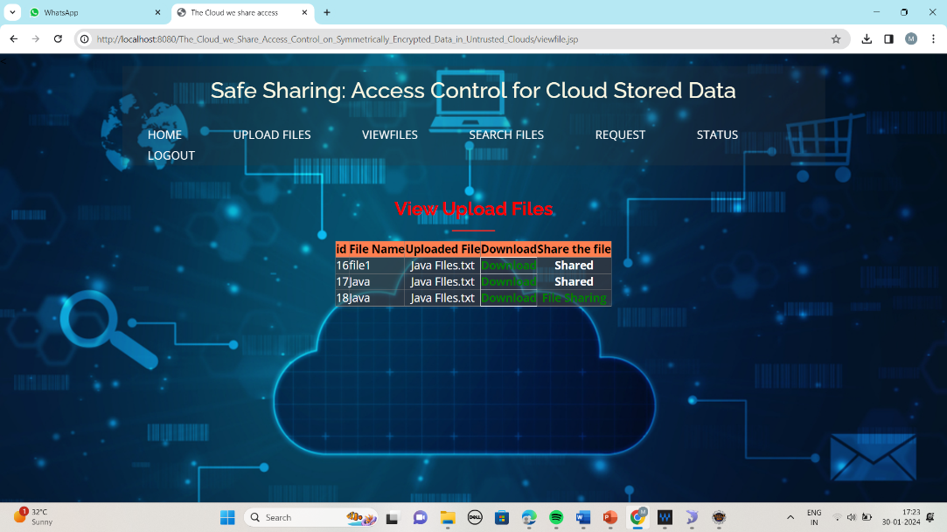
Output
Output Screens :

Slide 11
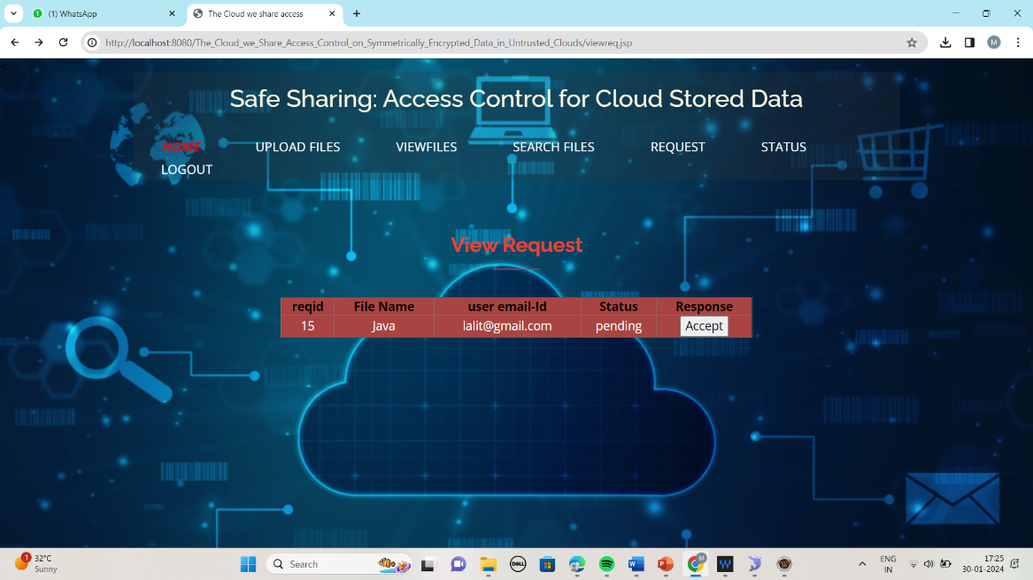
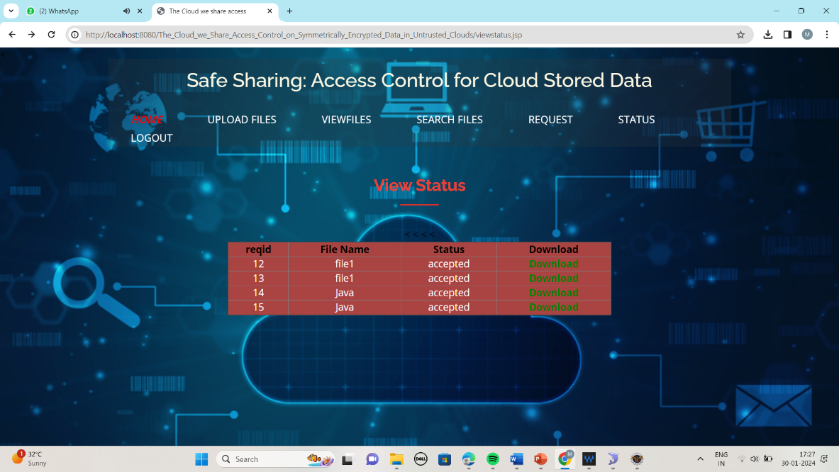
Implementation

Slide 12
Conclusion
Our project combines the strengths of both Symmetric Searchable Encryption (SSE) and Attribute-Based Encryption (ABE) to ensure secure data storage in cloud environments. SSE provides efficient search capabilities and protection against attacks, while ABE offers fine grained access control based on attributes and policies. By combining these two techniques, we aim to create a web application that meets the diverse security needs of our users

Slide 13
References
[1] S. Agrawal and M. Chase, ‘‘FAME: Fast attribute-based message encryption,’’ in Proc. ACM SIGSAC Conf. Comput. Commun. Secur., Oct. 2017, pp. 665–682.
[2] G. Amjad, S. Kamara, and T. Moataz, ‘‘Forward and backward private searchable encryption with SGX,’’ in Proc. 12th Eur. Workshop Syst. Secur. (EuroSec). New York, NY, USA: Association for Computing Machinery, 2019.
[3] A. Bakas and A. Michalas, ‘‘Modern family: A revocable hybrid encryption scheme based on attribute-based encryption, symmetric searchable encryption and SGX,’’ in Security and Privacy in Communication Networks, S. Chen, K.-K. R. Choo, X. Fu, W. Lou, and A. Mohaisen, Eds. Cham, Switzerland: Springer, 2019, pp. 472–486.

Slide 14
References
[4] A. Bakas and A. Michalas, ‘‘Multi-client symmetric searchable encryption with forward privacy,’’ Cryptol. ePrint Arch., Tampere Univ., Tampere, Finland, Tech. Rep. 2019/813, 2019. [Online]. Available: https://eprint.iacr.org/2019/813
[5] A. Bakas and A. Michalas, ‘‘Power range: Forward private multi-client symmetric searchable encryption with range queries support,’’ in Proc. IEEE Symp. Comput. Commun. (ISCC), Jul. 2020, pp. 1–7.

Slide 15
Thank You!!!

